Slide 1
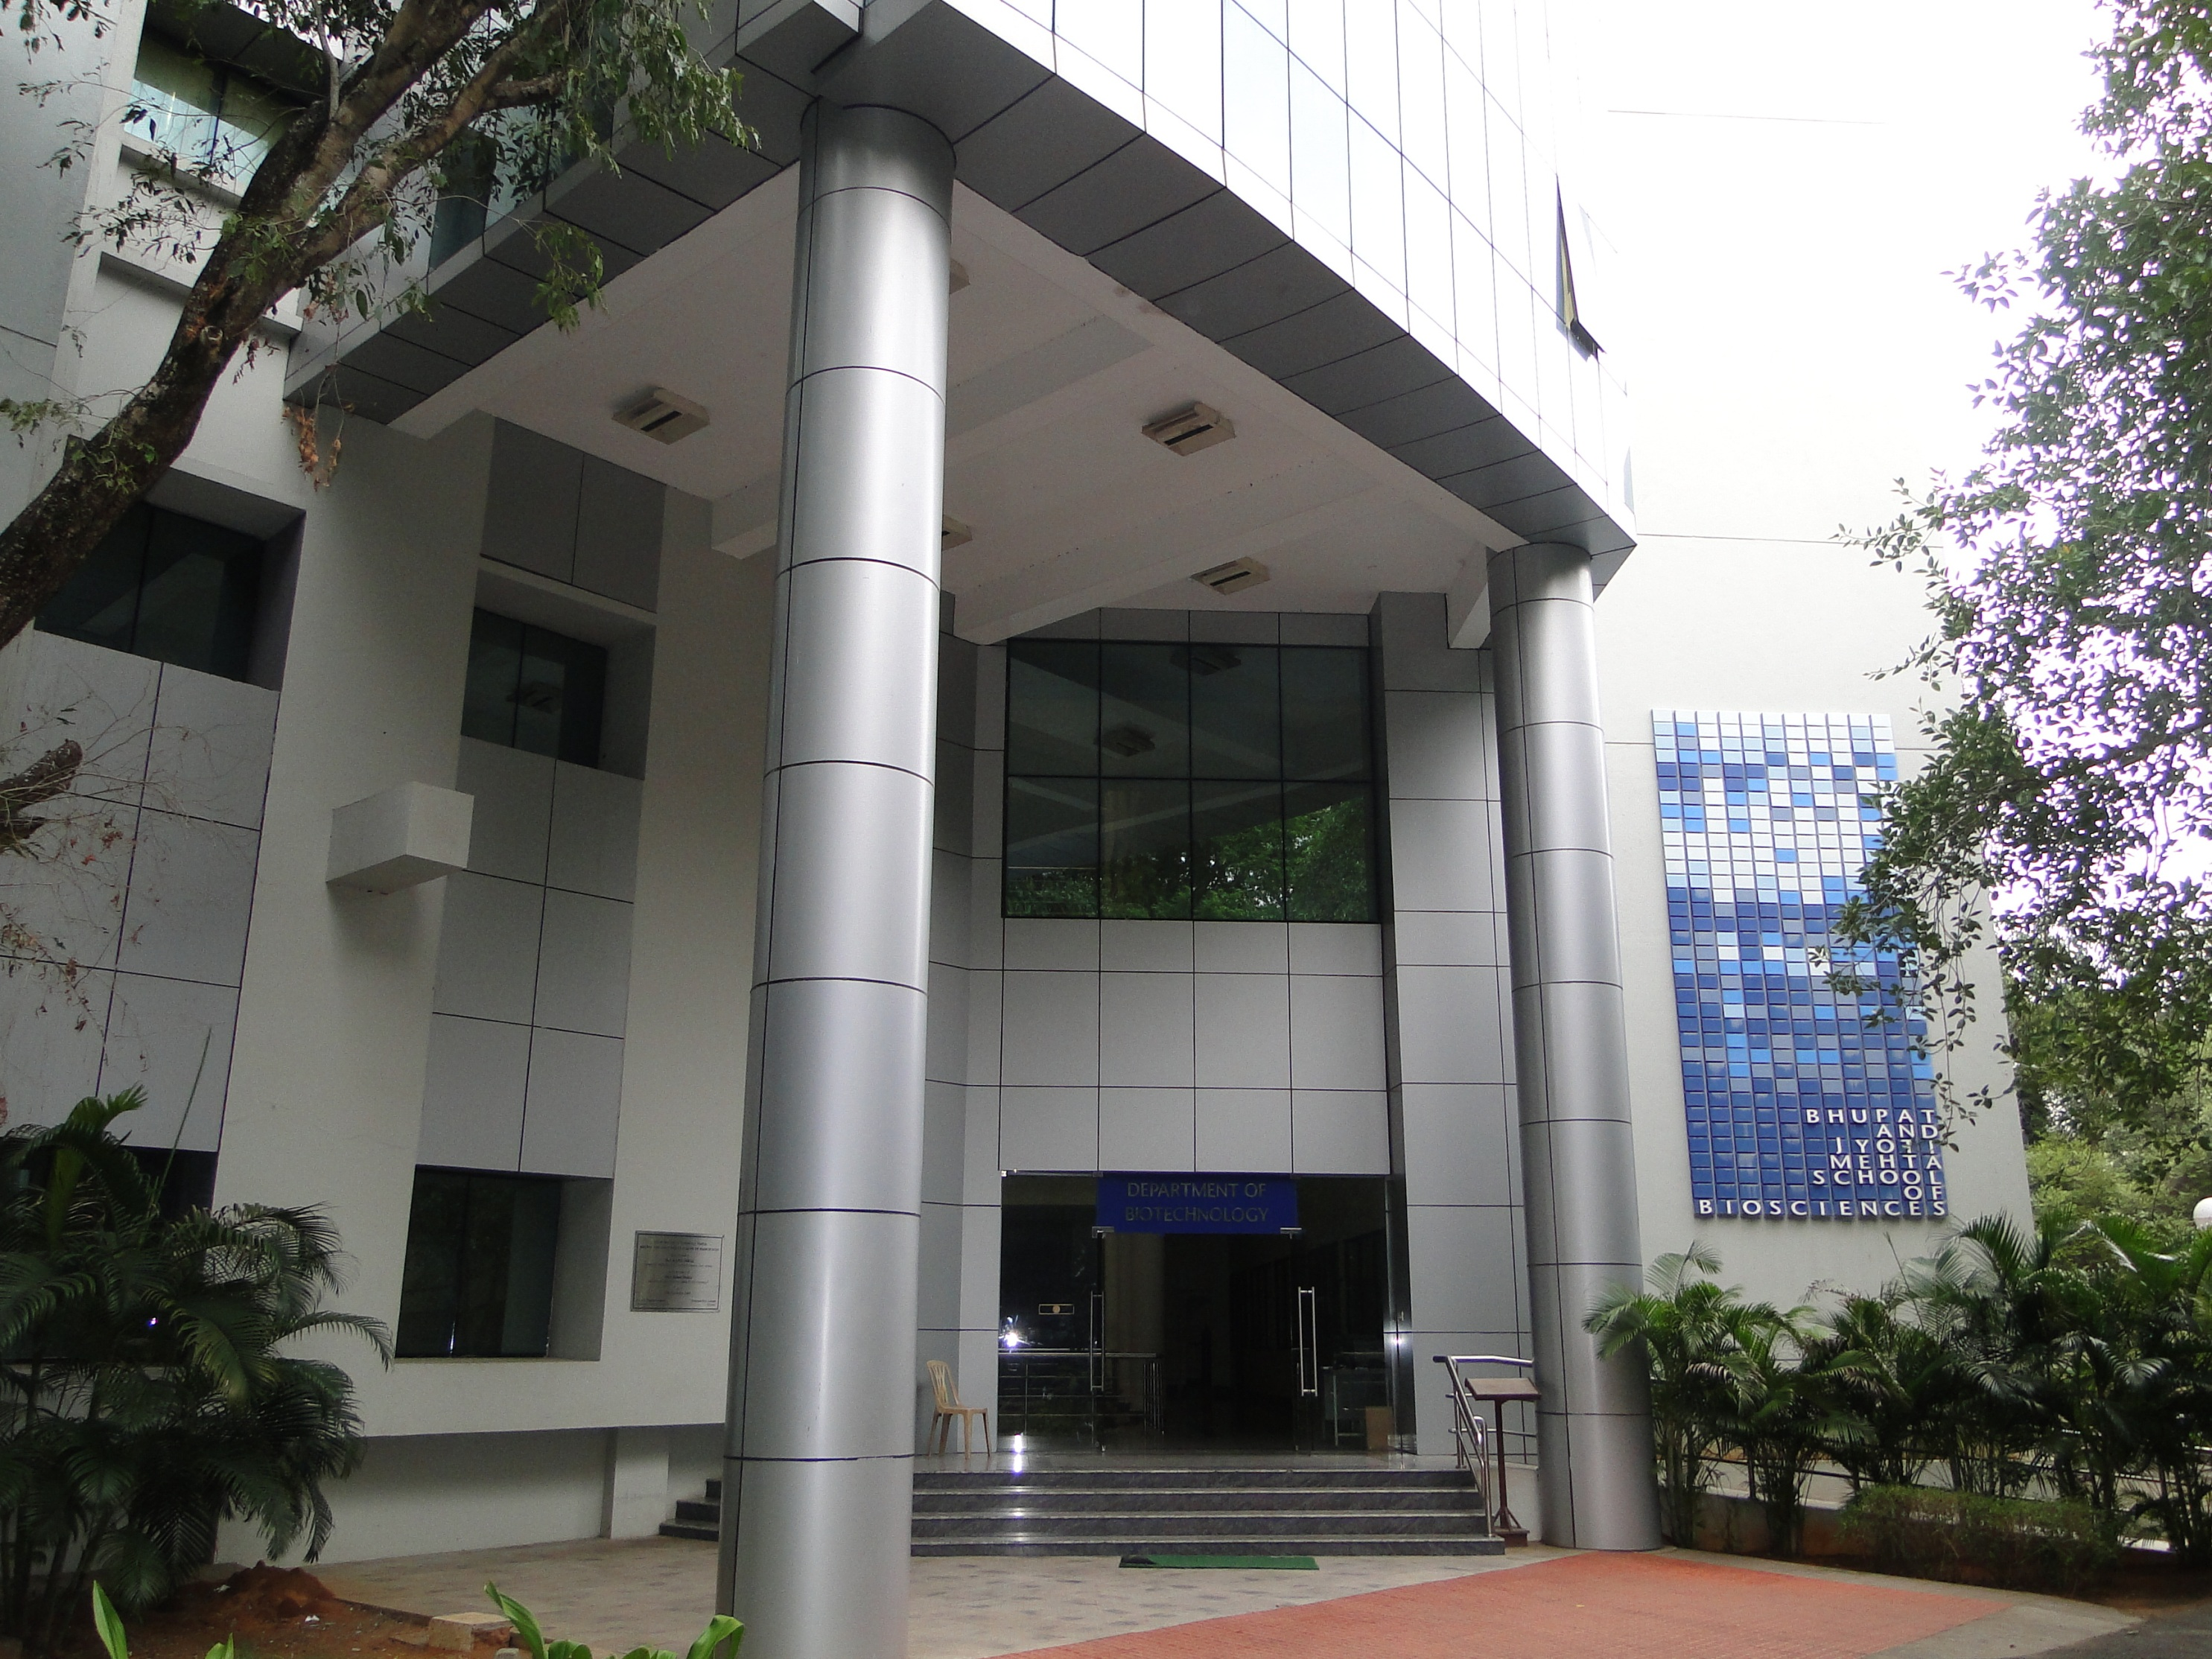
Review of Department of Biotechnology, IIT Madras Bhupat & Jyoti Mehta School of BioSciences

Slide 2
The Department
Founded in 2004
Vision: To be recognised as a department of International repute with a strong interdisciplinary research and teaching base in biological sciences and engineering and an active collaboration with industries and health-care institutions

Slide 3
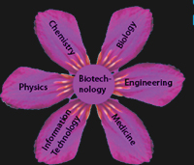
The Department
28 faculty members (1 Emeritus), 250 under-grads, 180 Research scholars
Wide-ranging research: from basic
research in molecular basis of
life processes to applied research in
modern biotechnology

Slide 4
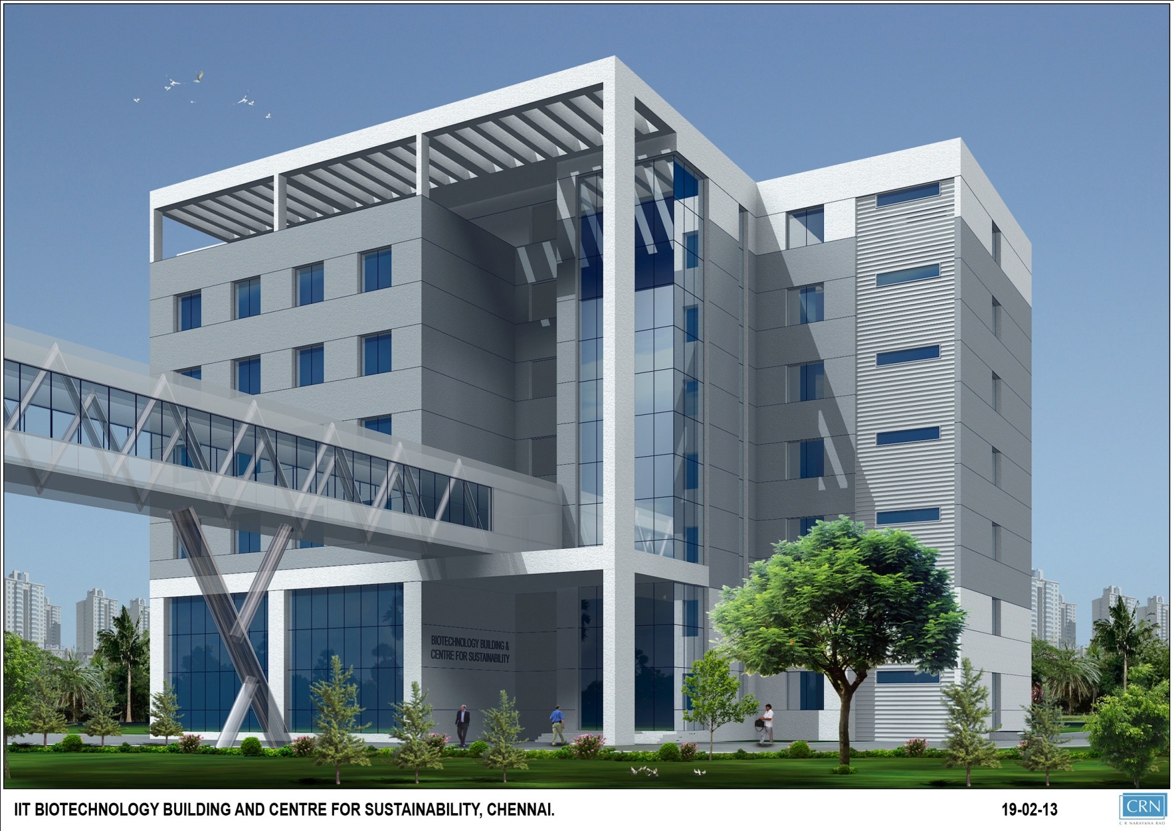
Proposed BIOTECH II

Slide 5
Programmes offered
Dual Degree – B. Tech & M. Tech in
Biological Engineering (5 years)
Dual Degree – B.S and M.S. in Biological Sciences (5 years)
M. Tech in Clinical Engineering (2½ years)*
M. S. by research (2–3 years)
Ph. D. (~ 5 years) *M. Tech (Clinical Engineering) and Ph. D. (Biomedical devices and Technology) are multi-institutional programmes, involving IITM, CMC (Vellore) & SCTIMST (Thiruvananthapuram)

Slide 7
PRODUCTS
HEALTH/ MEDICAL
Biological Sciences
Biological Eng.
VM
AKB
RB
KBR
TSC
AGK
DK
GJ
KCR
GK
SM
MDX
SCV
GSN
MN
SR
SSV
KR
RSV
Computational
Biology
NM
MD
AN
HPMS
SS
MG
VK
JK
RM
AC
Chemical Biology
ENVIRONMENT
ENERGY

Slide 8
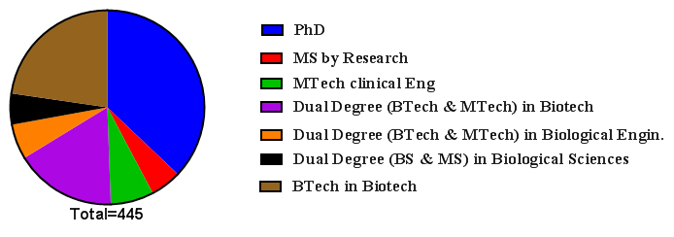
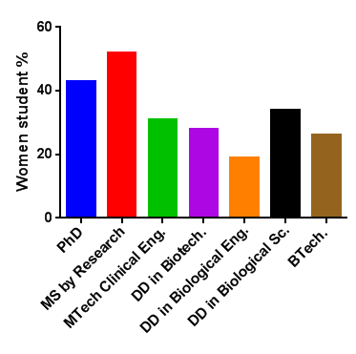
Total numbers in BT, DD, MTech, MS, Ph.D others
Total #101
Total # 165
23
26
75
32
23
52%
43%
34%
Women students in each category
31%
28%
26%
19%

Slide 9
Staff
Tech staff
On roll: 5
Anticipated recruitment: 4
Ministerial staff: 6
Contract staff (DDF project, MaFoi,…): 65
Project Staff: 7

Slide 10
Class sizes for courses in 2012-13
Number of courses
PG
Number of courses
UG
Number of students per class

Slide 12
Major Teaching Lab facilities
Name of lab
Bioprocess lab
Biochemistry/molecular biology/Microbiology lab
Name of lab course, BT/MT, approx. no. of students in course
Bioreaction Engineering, No of students: 70
Downstream processing 70
Biochemistry 70
Molecular biology and Genetic engineering 70
Microbiology 70
Microbiology and Biochemistry : 70
Bioinformtics 35

Slide 13
Faculty Research Labs
Molecular Oncology
Cancer biology
Cardiovascular Genetics
Signal transduction and Structural Biology
Stem Cell Research
Vascular Biology
Molecular Virology
Electrophysiology
Plant Genetics
Bio-organic and Chemical Biology
Theoretical Biophysics
Computational Biophysics and Neuroscience
Bioinformatics
Biomaterials
Bio-reaction Engineering
Bioengineering and Drug designing
Biomass conversion and Bioremediation
Applied Industrial and Microbiology
Plant cell Technology

Slide 14
Major equipment/instruments
Funding sources, mainly: MHRD, DBT, DST
Fourier Transform Infrared Analyser
Circular Dichroism Spectrometer
Differential Scanning Calorimeter
Fluorescent Microscopes
HPLC
FPLC
Gas Chromatograph
Micro plate Spectrophotometers
UV - Visible Spectrophotometers
Bioreactors
Gas Analyser
Lyophilizer
Gel Documentation System
High speed and Ultra Centrifuges
Confocal Microscope
Cell Counters
Real-time PCR
Electric Cell Impedance System
Live Cell Imaging system
Patch Clamp recording set up
Flow Cytometer
DNA sequencer
FOSS NIR System
FACS,
SPR
LCMS
Xray Diffractometer

Slide 15
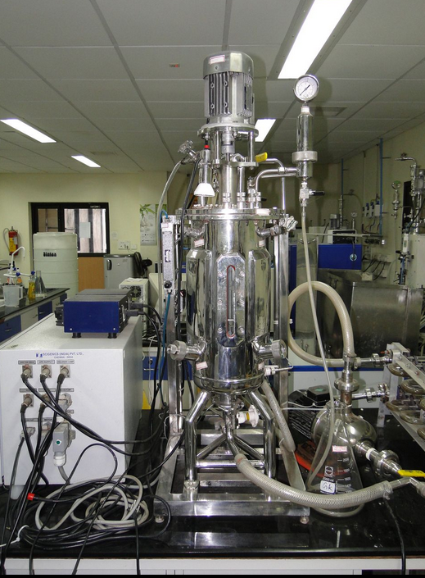
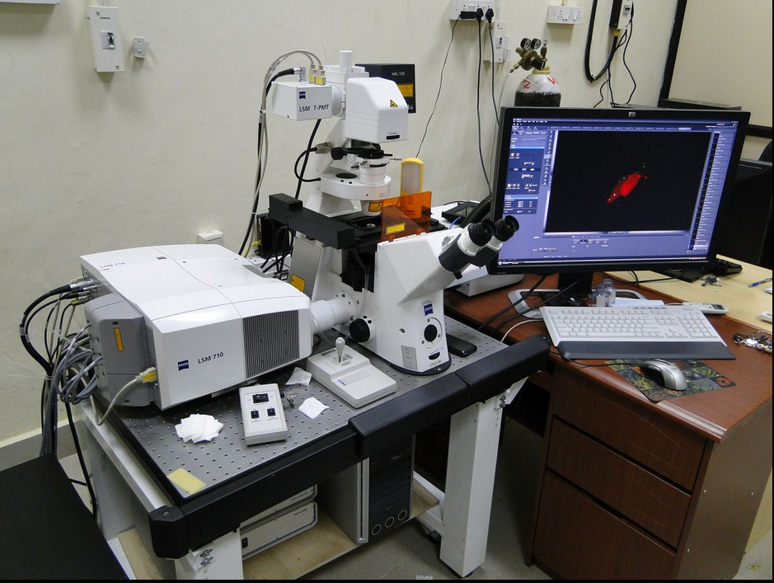
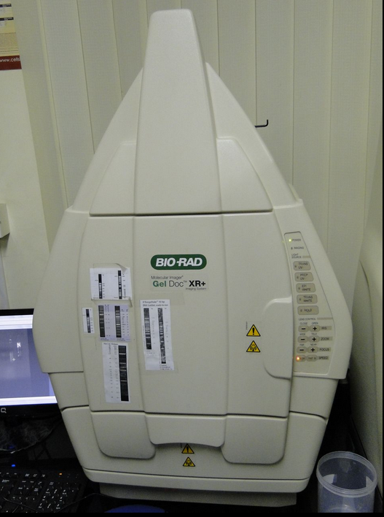
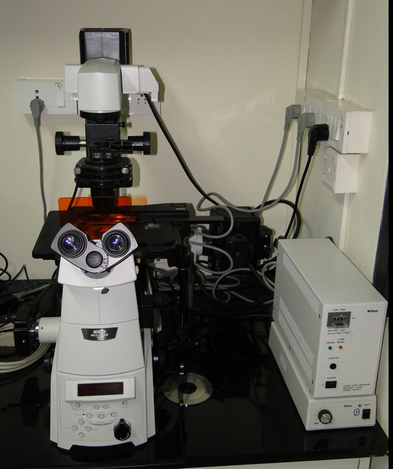
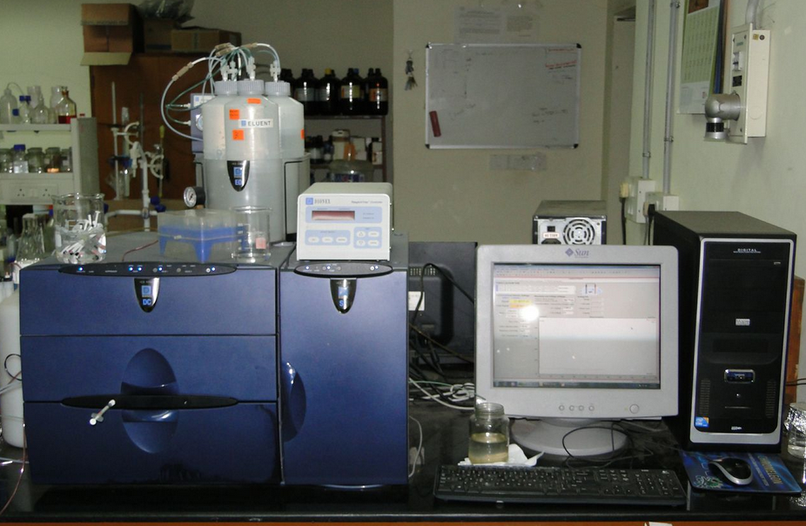
Bioreactor
Confocal microscope
Fluorescence Microscope
HPLC
Gel doc

Slide 16
Major topics of current research undertaken
Studies on signal transduction mechanisms associated with Diabetes, Cancer, AIDS, stroke
Hyper tension and cardio vascular diseases
Studies on structure - function relationship of different enzymes, membrane proteins,
ion channels and receptors
Identification of novel biomarkers for the early detection of Cancer, AIDS, Fanconi anemia
and Cardiovascular diseases.
Stem Cell Biology
Drug designing and delivery
Development of Biocompatible polymers
Computational, theoretical and bioinformatics approach to understand protein : structure, folding ,
dynamics and stability; receptor-ligand interaction.
Modeling of Cardio vascular and neurological diseases
Statistical physics of biological system
Plant developmental biology & genetics, plant tissue culture, phytoremediation
Development of biosensors
Production of therapeutic proteins
Novel approaches for the production of bio-oils from algae
Bioprocess for production of ethanol, glucans, hyaluronicacid, oligosaccharides
and many other commercially important biomolecules.
Genetic and metabolic engineering approaches to improve the yield of commercially important bio-molecules from microorganisms.

Slide 18
Three institute (IITM, CMC, SCTIMST) Clinical Engineering programme

Slide 19
Industry Interaction
Number of short-term courses conducted for industry in 2012-13: 3
Details of UoP programmes
Medical Biotechnology with Frontier Lifeline Hospitals, Chennai
~ 15 students/year (2005 – 2007)
Number of lectures delivered by industry personnel in 2012-13: 15
(Industry lecture series)

Slide 20
Visiting researchers (last 5 yrs)
Number of international researchers who visited the department for a week or more
Students: 15 (attend classes , M.Tech projects)
faculty/industry researchers: 3

Slide 21
RESEARCH

Slide 22
Number of journal publications each year in the last 5 years
No. of publications

Slide 23
Histogram of number of faculty vs. number of Scopus publications in
April 2012 – Mar 2013

Slide 24
Comparison of publications with other IITs (2007-2012)

Slide 25
Publications by Course (BTech/Mtech) students in last 3 years
Rushendhiran, K., Potunuru, U.R., Nastasijevic, B., Avaneesh, T., Joksic, G. and Dixit, M. “Inhibition of vascular smooth muscle cell proliferation by Gentiana lutea root extracts.” (2013), PLOS One 8, e61393.
Karthik Raman, Nandita Damaraju and Govind Krishna Joshi (2013) "The organisational structure of protein networks: revisiting the centrality–lethality hypothesis" Systems and Synthetic Biology doi:10.1007/s11693-013-9123-5

Slide 26
Large research groups/centres
Sl. No | Agency | Title of the project/centre | Total amount Rs. In Lakhs | Period
1. | DBT, Govt. of India | Program support in Cancer Biology | 352.60 | 2008-2011
2. | DST, Govt. of India | National facility to identify potential drug targets through functional cell dynamics | 564.42 | 2008-2011
3. | DST, Govt. of India | FIST in the Subject Area of Life Sciences / Level II, DST - Setting up of Experimental Facility for Studies on Protein Structure-Function Relationship | 192.00 | 2011-2016
4 | MHRD | Center of Excellence in Bioprocess Engineering | 200.00 | 2008-2011

Slide 27
Large funding in 2013
National cancer tissue bank facility to the tune of Rs 31 crores
Bioenterpreneurship support facility for Rs 12 crores
Indo-Finland collaborative project on “Control of polymerisation using synthetic biology” for Rs 2 crores
INDO-US consortium partner working on the development of lignocellulosic biofuel for Rs 1 crore

Slide 28
Inter-disciplinary research
Title : System- level Investigation into Complex Diseases : Focus on Parkinson’s disease
and cardiac arrhythmia
Collaborating faculties with area in Brackets :
Dr. Guhan Jayaraman (Bioprocess), Dr. A. Gopalakrishna (protein chemistry/signal transduction)
Dr. S. Gummadi ( Bioprocess), Dr. R. Krishnakumar ( mechanical engineering), Dr. N. Manoj
( protein structure), Dr. Mukesh Doble ( Bioprocess), Dr. V. Srinivasa Chakravarthy
( computational neuroscience), Dr. Venkatesh Balasubramanian ( Ergonomics), Dr. Bharath
Srinivasan (Drosophila genetics)
Whether funded or not: yes
Whether PhD students are involved or not : No
Title : Application of Electrospun Nanofibres in Biology for packaging of foods, biofertilizers and biocides
Collaborating faculties with area in Brackets: Dr. Chandra ( Microbiology ) and Dr. Natarajan (Physics)
Whether PhD students are involved or not : yes
Title : Design and synthesis of peptide mini-vectors for receptor mediated delivery of siRNAs
Collaborating faculties with area in Brackets: Dr. V. Kesavan (Bioorganic Chemistry) and Dr. D. Karunagaran (Cancer Biology)
Whether funded or not: yes
Title : Development of a bioprocess for the production of polyhydroxy butyrate (PHB) from bio-diesel industry generated glycerol
Collaborating faculties with area in Brackets : Dr. K.B. Ramachandran (bioprocess) and Dr. T.S. Chandra (microbiology)
Whether funded or not: yes

Slide 29
Title : Studies on the ion the ion channels of stem cell
Collaborating faculties with area in Brackets :
Dr. Amal K. Bera ( Electrophysiology) and Rama S. Verma ( molecular biology and cell biology)
Whether funded or not: not
Whether PhD students are involved or not : yes
Title Collaborating faculties with area in Brackets : Dr. Anju Chadha (Bio-organic chemistry) and S.N. Gumadi (Bioprocess)
Whether funded or not: yes
Whether PhD students are involved or not : yes
Title: Genetic dissection of pattern formation in the cellular slime mold polysphondylium
Collaborating faculties with area in Brackets : Dr. Baskar R (plant genetics) and V. Kesavan (Bio-organic chemistry)
Whether funded or not: yes
Whether PhD students are involved or not : yes
Title : Evaluation of the performance of a recombinant thermostable endoglucanase under process conditions
Title: Engineering of a recombinant thermostable acetyl xylan esterase for enhanced properties
Title : Biochemical and biophysical characterization of AnaEst, an arylesterase from anabaena sp PCC 1720
Collaborating faculties with area in Brackets : Dr. N. Manoj ( structural biology) and S.N. Gumadi (Bioprocesses)
Whether funded or not: yes
Whether PhD students are involved or not : yes

Slide 30
Title : Control of in vivo polymerisation using synthetic biology approaches: Guhan Jayaraman (metabolic engineering) and Karthik Raman (systems biology);
Funded: yes (DBT);
PhD students: Yes (not joint though)
Title :Enhanced production of alpha -tocopherol by genetically transformed cell culture of Helianthus annus L.: Smita Srivastava (Biochemical Engineering), Baskar R (plant biology) and Karthik Raman (systems biology);
Funded: yes (DBT);
PhD students: yes (one)
Title :Massively parallel in silico phenotyping of metabolic networks: Karthik Raman (systems biology) and Shankar Balachandran (CS);
Funded: no;
PhD students: No (1 MS student)
Title : Engineering a Consortia of Microbes for Production of Bio-ethanol: Karthik Raman (systems biology) and Smita Srivastava (Biochemical engineering);
Funded: no;
PhD students: yes (one)

Slide 31
Title : Cellular and molecular studies on interaction of the physiological anti-hypertensive peptide
catestatin at the neuronal nicotinic acetylcholine receptor
Collaborating faculties with area in Brackets : Dr. Nitish Mahapatra (Human genetics) and Amal K. Bera (Electrophysiology)
Whether funded or not: yes
Whether PhD students are involved or not : yes
Title : P21 activated kinase 1 (PAK 1) mediated protective role of probiotics in inflammatory bowel disease
Collaborating faculties with area in Brackets : Dr. Rayala Sureshkumar (Cancer Biology) and K.B. Ramachandran (Bioprocess)
Whether funded or not: yes
Whether PhD students are involved or not :
Title : Studies on the functional and clinical significance of a nuclear receptor co regulator in Parkinson disease
Collaborating faculties with area in Brackets : Dr. Rayala Sureshkumar (Cancer Biology) and V. Kesavan (Bioorganic chemistry)
Whether funded or not: yes
Whether PhD students are involved or not :

Slide 32
Title : Studies on the biochemical, biophysical and functional characterization of human phospholipid scramblase 1(hPLSCR1) interaction with topoisomerase II
Collaborating faculties with area in Brackets : S.N. Gumadi (Bioprocess) and A. Gopalakrishna (protein chemistry)
Whether funded or not: yes
Whether PhD students are involved or not :
Title : Development of Online Handwriting Recognition system for Indian language (OHWR) - Phase II - Deployment of an application and improvement of engine performance
Collaborating faculties with area in Brackets : Dr. Srinivasa Chakravarthy (Computational Neuroscience) and C. Chandrasekhar (CS)
Whether funded or not: yes
Whether PhD students are involved or not :

Slide 33
Sponsored projects
Consultancy projects

Slide 34
Research with Immediate Societal Impact in last 5 years

Slide 35
Science popularization:
Srinivasa Chakravarthy
Has written books in Telugu for a popular audience on Charles Darwin, Srinivasa Ramanujam, Vasco da Gama, Galileo, Christopher Columbus, historical anecdotes in mathematics, measuring astronomical distances, exploration and colonization of Mars, etc.,
Has translated into Telugu, about 10 books by various authors: Jagdish Chandra Bose, Michael Faraday, John Holt, Gamow, Arthur C. Clarke, etc.,
Has translated 27 books by Isaac Asimov under the `Science Fact’ Masterpieces: How did we learn about - Beginnings of Life, Genes, DNA, Photosynthesis, Germs, Life in the Deep Sea, Superconductivity, etc.,
Has authored a weekly science column in `Andhra Bhoomi’, a Telugu daily
Is the author of a science blog in Telugu, http://scienceintelugu.blogspot.in with over 1 lakh hits
Popular lectures in schools by many faculty in the Department

Slide 36
Project
Power generation in rural areas using biogas from non-edible oil cakes
T. S. Chandra and K. B. Ramachandran
Funded by: IIT Alumni (8.5 lakhs)

Slide 38
Awards
The computational biology group of BT, IIT Madras was recognised by DBT, GoI, (20130) as one of the top performing centre (based on publications and impact factor) amongst 157 other Bioinformatics centres in India.
Innovative Young Biotechnologist Award (2012) from the Department of Biotechnology, New Delhi, India- Athi Narayanan
NASI-SCOPUS , Elsevier awards by Dr Sanjib Senapati (2011) and Prof. Sathyanarayan Gummadi (2012)
…………………….
Fellow
Indian Academy of Sciences - A. Jayakrishnan
Royal Society of Chemistry, England – Mukesh Doble

Slide 39
IPR and Innovation

Slide 40
Patents filed in last 5 years
Faculty Name : Dr. Anju Chadha
National/ International
Year of Filing : 2008 -2009
Area/Topic : Process for the preparation of optically pure Amino acids using Biocatalytic Deracemisation reaction
Faculty Name : Dr. Rama S. Verma
National/ International
Year of Filing : 2009 -2010
Area/Topic : Micro-array data at NCBI . A diphtheria toxin –stem cell factor protein targeted biotherapy of c-Kit tumors
Faculty Name : Dr. Mukesh Doble
National/ International
Year of Filing : 2011
Area : New Anti-tuberculosis antibiotic from marine actinomycetes strain R2,/247/DEL/2011
Faculty name(s) : Dr. Rama S. Verma
National/ International
Year of Filing :
Area/topic : i. GSE17233 – involved in fanconi anemia

Slide 41
IP granted
Faculty name(s) : Dr. Anju Chadha
area/topic of IP : i. A process for the lipase catalysed preparation of alkyl and aryl esters of hydrocinnamic acid.
ii. A process for the Monoacylation of Polyols with Alkyl and Aryl Beta-ketoesters.
Faculty name(s) : Dr. GK Suraishkumar
area/topic of IP : A bioreactor for plant shoot culture

Slide 42
Incubation in last 5 years
Companies incubated by faculty and students
Name of company: Sea6 Energy
Name(s) of founder(s):
Sayash Kumar, Sailaja Nori, Nelson Vadaserry, Sowmya, Shrikumar Suryanarayan
Year of incubation: 2010
Product name/category: Seeweed biofuel
Any information on current status (cash flow positive, pilot stage,…): Rs. 1 crore

Slide 43
Incubation in last 5 years
Companies incubated by faculty and students
Name of company: Purius Nanosystems
Name(s) of founder(s): G Purushothaman and S Kousik
Year of incubation: 2012
Product name/category:
Portable Multipurpose Diagnostic Device
Any information on current status (cash flow positive, pilot stage,…): Rs. 10 lakhs. 2012-2015

Slide 44
Incubation in last 5 years
Companies incubated by faculty and students
Name of company: Life Catalyst Technologies
Name(s) of founder(s): Namrata Kamat, Sagar Laygude, Rajeshekar Reddy
Year of incubation: 2013
Product name/category:
Low cost blood glucose sensors

Slide 45
Incubation in last 5 years
Companies incubated by faculty and students
Name of company:
Name(s) of founder(s):
Year of incubation: 2013
Product name/category:
Biofertiliser

Slide 46
Placement

Slide 47
Year | B.Tech. % | DD % | M.Tech. % | M.S. %
2009 - 10 | 74 | 71 | n.a. | 50
2010 - 11 | 74 | 50 | 100 | 0/1
2011 - 12 | 56 | 81 | 100 | 33
Biocon Limited
HCL Technologies
Global Hospitals
IITM Research Park
Schlumberger
Larsen and Toubro
Wipro Technologies
Flipkart
Cognizant
Deloitte

Slide 48
Placement of PhD in last three years
Data obtained from faculty
No. of post docs: 12
No. entering academics: 07
No. entering industry in India: 13
No. going to industry abroad: 0
Star placements (list them)
Job: Biocon, Dr. Reddys, GE Healthcare, NALCO, CCMB Post-doc: MIT – USA, U. Cambridge, IISc

Slide 49
Students’ Achievements-AWARDS
B. Tech team ‘Nidan’ featured among the top ten teams in the BEST (Biotechnology Entrepreneurship Student Team) competition organised by ABLE and DBT (2011)
Gold medal at the International Genetically Engineered Machine competition (iGEM) at MIT (USA) (2010), Hongkong regional conf (2011)
Silver medal at iGEM (MIT, USA) 2009, 2008
Life Catalyst Technologies recently won the grand prize at the INDIAFRICA Business Venture Contest and they will present their idea at the World Economic Forum meeting in January 2014 at Davos, Switzerland
Gold medal at the International Genetically Engineered Machine competition (iGEM) at Hongkong regional conf (Oct 2013)

Slide 50
Vision for department

Slide 51
Vision
No. of faculty, Ph.D students in 2016:
The Department is about 9.5 years old.
Highly interdisciplinary nature
Now, at 29+ faculty, it would be best to grow slow, for the next few years. May be 35 faculty members in 2016. We already have close to 180 PhD students
That is about 6 per faculty, on the average. It would be desirable to stabilize at around 200.

Slide 52
Vision
Emerging Areas of focus Any new faculty in these areas
Bio-nano
Stem cells
Genomics and Proteomics

Slide 53
Vision
Industry collaboration
More collaborations with Research Park companies
More collaborations with Life-science verticals of many companies (say, TCS, etc.,)
Adjunct appointments for industry personnel in the Dept.
problems of people from the industry can be suitably defined
Take help of our PhD alumni who are in the industry (32%)

Slide 54
Vision
Although the department has good infrastructure in
Proteomics and genomics
Bioprocess
We are in need of
Better imaging facilities (although we have confocal, fluroscence and live cell imaging systems),
Surface characterization tools for biomaterials research (such as SEM, AFM)
NMR for Chemical biology research.

Slide 55
Vision
With the proposed BioSciences II building there will be easing of pressure on lab space.
Animal house is also planned in the new building hence faculty can pursue their in vivo studies in-house instead of the current practice of looking at other places to perform these studies.

Slide 56
Vision
Research for immediate societal impact
List challenges sought to be tacked
In the areas of
energy
environment
health

Slide 57
Course programmes
Vision
Vision for course programmes in 2016 We have introduced two new programmes (Biological engineering and Biological science) and so will not plan for additional programmes
In the next 5 to 10 years we may add specialized M.Tech programmes such as Computational biology and Biochemical engineering.
Avg. no. of electives offered per year in last three years: 20 per year
Projection for 2016: 25
No. of minor streams offered by dept in 2012: none we introduced 2 in 2013
Projection for 2016 no extra
Projection for class sizes in 2016: same; 70 per year
Curricular strategy, if any: status quo with emphasis on improving the learning and evaluation aspects as well as improvement in the learning experimental aspects

Slide 58
Patents and IP
Vision
Departmental Objectives on patenting and IP
Strategy for meeting objectives
About 3 patent filing a year, for the next 3 years
Encouraging faculty toward translational aspects of their research.
Encouraging better industrial collaborations.
Better counseling of patenting strategies by the patent cell (IC&SR) for faculty who believe in patenting and the inexperienced ones.

Slide 59
Incubation
Vision
To create knowledge and develop entrepreneurship in Biotechnology; focus sectors: Biopharma, Bioagri, Industrial Biotechnology and Bioenergy.
The Enterprise should be built around an innovative scientific or business idea connected with the life-sciences.

Slide 60
Proactive steps: Bioincubator
Vision
Bioincubators/Innovation center for SMEs and start-ups
Biotechnology Entrepreneur Support Scheme
Will call for proposals for availing the incubation facility (all India).
Forming a Governing body to oversee the functioning of the facility (administrative, managerial, technical, financial and other issues) with one DBT/BIRAC member. Will meet twice a year.
Forming a Technical committee to scrutinize the applications for incubation and monitor their progress every six months.

Slide 61
Grand Vision
Vision
Research: in issues of local relevance – diseases, energy, environment
Curricula, programmes: lean UG programs leading to competent undergraduates, and robust PG programs leading to competent, independent researchers on graduation; Integrated Sciences (Biology, Mathematics, Physics, Chemistry) MS program
Student output quality: better trained to be independent researchers
Industry-funded research: Drug development programs with industry
Incubation: 10 student companies incubated by 2016
Commercialization success: at least two in the next 10 years

Slide 62
THANKS

Slide 63
5YEAR SPONSORED PROJECTS
MUKESH DOBLE |  | Biocompatibility studies on nanoparticle coated polymer surface | Board of Research in Nuclear Sciences | 16-04-2008 | 31-03-2012 | 20.60
VENKATESH BALASUBRAMANIAN |  | Wearable wireless sensors for tracking trainee's body | Army Technology Board | 30-05-2008 | 31-07-2010 | 18.00
AMAL KANTI BERA |  | Modulation of the voltage dependent anion channel of mitochondria by the proteins of BCL-2 family | Defence Research and Development Organisation | 01-01-2009 | 31-03-2012 | 24.21
MADHULIKA DIXIT |  | Molecular and functional characterization of EPCs in Polycystic Ovary Syndrome: A preliminary study | Appollo Hospitals, Educational and Research Foundation | 21-07-2008 | 31-03-2010 | 6.00
SURAISH KUMAR G K |  | Reactive oxygen species and chlorine based microbial inactivation | INDO-US Science & Technology Forum (IUSS) | 05-09-2008 | 04-09-2010 | 12.90
GUHAN JAYARAMAN |  | Drosophila fly-lab models for parkinson's disease and cardiac arrhythmias | IIT Madras Research Foundation | 17-10-2008 | 31-03-2013 | 3.50
RAMA S VERMA |  | Studies on proliferation and differentiation of stem cells and cancer cells under microgravity | Defence Research and Development Organisation | 10-02-2009 | 09-02-2012 | 25.00
MAHALINGAM S |  | Role of nucleolar GTPases on cell proliferation during tumorigenesis | Department of Atomic Energy | 28-03-2009 | 27-03-2014 | 100.00
RAYALA SURESH KUMAR |  | Unraveling and targeting the molecular mechanism behind UV-induced skin cancer | Defence Research and Development Organisation | 05-08-2010 | 04-08-2013 | 29.28

Slide 64
NITISH RANJAN MAHAPATRA |  | Identification and functional characterization of regulatory elements in the mouse Hspa1a Gene | Defence Research and Development Organisation | 30-04-2009 | 03-10-2012 | 42.16
RAYALA SURESH KUMAR |  | Targeting P21-activated kinase 1 (Pak1) signaling in acute myeloid leukemia | Lady Tata Memorial Trust | 01-10-2009 | 30-09-2010 | 9.90
AMAL KANTI BERA |  | Mechanisms of P2X7 receptor mediated pore formation in neuron | Board of Research in Nuclear Sciences | 06-01-2010 | 31-03-2013 | 19.89
RAYALA SURESH KUMAR |  | Targeting P21 activated kinase 1 (Pak1) signaling in head & neck cancers | Department of Atomic Energy | 12-04-2010 | 11-04-2013 | 20.18
CHANDRA T S |  | Effect of sorghum whole grain diet or sub-components on human health | Directorate of Sorghum Research | 16-03-2010 | 31-03-2012 | 15.00
SRINIVASA CHAKRAVARTHY V | CHANDRA SEKHAR C | Development of Online Handwriting Recognition system for Indian language (OHWR) - Phase II - Deployment of an application and improvement of engine performance | Department of Information Technology | 01-05-2010 | 30-04-2013 | 58.20
RAYALA SURESH KUMAR |  | Production of immunoassay compatible monoclonal antibodies against human thyroid stimulating hormone (hTSH) and their application in immunoassay development | Board of Research in Nuclear Sciences | 05-01-2012 | 04-01-2015 | 34.99
NITISH RANJAN MAHAPATRA |  | Molecular mechanisms of regulation of the cystathionine r-lyase gene | Board of Research in Nuclear Sciences | 06-01-2012 | 05-01-2015 | 24.15

Slide 65
MUKESH DOBLE | RAVI KUMAR | Development of antifouling coating based on surface modification approach | Board of Research in Nuclear Sciences | NULL | NULL | 53.90
MANOJ N |  | The evolutionary origin of membrane bound proteins | Uppsala University Sweden | 28-08-2012 | 27-08-2015 | 50.14
CHANDRARAJ K |  | US-India Consortium for development of Sustainable Advanced Lignocellulosic Biofuel Systems | Indo-US Science & Technology Forum | 10-01-2013 | 09-01-2018 | 84.51
GOPALAKRISHNA A |  | Signal transduction mechanism of a novel calcium binding protein calumenin | Board of Research in Nuclear Sciences | NULL | NULL | 23.52
SATHYANARAYANA NAIDU G | RAYALA SURESH KUMAR | Studies on the biochemical, biophysical and functional characterization of human phospholipid scramblase 1(hPLSCR1) interaction with topoisomerase II | Board of Research in Nuclear Sciences | NULL | NULL | 27.05
KESAVAN V |  | Novel nanotechnological approaches for treatment of leishmaniasis using 2-propylquinoline | Indo_French Centre for the Promotion of Advance Research | 17-01-2013 | 16-01-2016 | 42.17

Slide 66
5 YEAR CONSULTANCY PROJECTS
RELIANCE INDUSTRIES LTD, MUMBAI | BIODEGRADATION OF POLYPROPYLENE | 02-02-2007 | 31-03-2013 | MUKESH DOBLE | 10.00 | 22.00
TVS MOTOR COMPANY LTD., HOSUR | QUANTITATIVE ASSESSMENT OF EFFECT OF RIDER POSTURE ON RIDING FATIGUE AND VEHICLE HANDLING | 01-09-2008 | 31-08-2009 | BALASUBRAMANIAN V | 5.53 | 3.00
EID PARY (LIFE SCIENCES) | BIOCATALYTIC TRANSFORMATION OF W-3 FATTY AIRDS | 09-02-2009 | 07-05-2012 | ANJU CHADHA | 20.49 | 12.24
ORCHID CHEMICALS & PHARAMACEUTICALS LTD., CHENNAI - 600 119 | RETAINER CONSULTACNCY SERVICES | 01-05-2007 | 30-04-2008 | RAMACHANDRAN K B | 4.66 | 1.05
THIRUMALAI CHEMICALS LTD. RANIPET | RETAINER CONSULTANCY SERVICES | 01-01-2008 | 31-12-2008 | RAMACHANDRAN K B | 4.00 | 3.03
ORCHID CHEMICALS & PHARMACEUTICALS LTD., | RETAINER CONSULTANCY SERVICES | 01-05-2008 | 30-04-2009 | RAMACHANDRAN K B | 4.20 | 3.15
RISHABH ENTERPRISES | TECHNICAL OPINION FOR MANITOL/POPLYOL | 10-03-2010 | 31-12-2010 | CHANDRARAJ K | 0.20 | 0.20
RMZ CENTENNIAL CAMPUS B BANGALORE | QUANTITATIVE STRUCTURE PROPERTY RELATIONSHIPS | 01-04-2009 | 31-03-2012 | MUKESH DOBLE | 6.00 | 6.00
LAILA PHARMACEUTICALS PVT LTD | EVALUATION OF PHYTO PHARMACEUTICAL USING | 01-04-2009 | 30-09-2014 | RAMA S VERMA | 1.00 | 1.50
THIRUMALAI CHEMICALS LTD. RANIPET | RETAINER CONSULTANCY SERVICES | 01-01-2008 | 31-12-2008 | RAMACHANDRAN K B | 4.00 | 0.34
ORCHID CHEMICALS & PHARMACEUTICALS LTD., | RETAINER CONSULTANCY SERVICES | 01-05-2008 | 30-04-2009 | RAMACHANDRAN K B | 4.20 | 0.70
ORICHID CHEMICALS & PHARMACEUTICALS LTD. | RETAINER CONSULTANCY SERVICES | 01-05-2009 | 30-04-2010 | RAMACHANDRAN K B | 4.20 | 3.50

Slide 67
AAAA | COMMON TESTING FACILITY | 09-07-2009 | 08-07-2011 | KARUNAGARAN D | 2.50 | 0.32
RISHABH ENTERPRISES | TECHNICAL OPINION FOR MANITOL/POPLYOL | 10-03-2010 | 31-12-2010 | CHANDRARAJ K | 0.20 | 0.45
NITREX CHEMICALS INDIA LIMITED | LABORATORY PROCESS FOR THE PRODUCTION OF BUTANOL BY FERMENTATION | 05-09-2006 | 31-03-2011 | MUKESH DOBLE | 10.00 | 6.00
RELIANCE INDUSTRIES LTD, MUMBAI | BIODEGRADATION OF POLYPROPYLENE | 02-02-2007 | 31-03-2013 | MUKESH DOBLE | 10.00 | 16.55
TVS MOTOR COMPANY LTD., HOSUR | QUANTITATIVE ASSESSMENT OF EFFECT OF RIDER POSTURE ON RIDING FATIGUE AND VEHICLE HANDLING | 01-09-2008 | 31-08-2009 | BALASUBRAMANIAN V | 5.53 | 3.21
EID PARY (LIFE SCIENCES) | BIOCATALYTIC TRANSFORMATION OF W-3 FATTY AIRDS | 09-02-2009 | 07-05-2012 | ANJU CHADHA | 20.49 | 6.24
LAILA PHARMACEUTICALS PVT LTD | EVALUATION OF PHYTO PHARMACEUTICAL USING | 01-04-2009 | 30-09-2014 | RAMA S VERMA | 1.00 | 0.50
HENKEL AG & CO. GERMANY | MICROBIAL POPULATION ANALYSIS DURING DETERGENT WASHING OF FABRICS | 04-01-2010 | 30-06-2011 | CHANDRARAJ K | 30.00 | 17.99
SREE RAMCIDES CHEMICALS PVT LTD, | SCREENING OF MICROORGANISMS PRODUCING LACTONE BASED BIO-PESTICIDE | 01-02-2011 | 31-03-2013 | CHANDRARAJ K | 15.00 | 7.50
PHILLIPS ELECTRONICS INDIA LTD | RETAINER CONSULTANCY SERVICES | 01-06-2009 | 30-11-2009 | BALASUBRAMANIAN V | 0.66 | 0.66
ORICHID CHEMICALS & PHARMACEUTICALS LTD. | RETAINER CONSULTANCY SERVICES | 01-05-2009 | 30-04-2010 | RAMACHANDRAN K B | 4.20 | 0.35
ORCHID CHEMICALS & PHARMACEUTICALS LTD CHENNAI | RETAINER CONSULTANCY SERVICES | 01-05-2010 | 30-04-2011 | RAMACHANDRAN K B | 4.20 | 2.80

Slide 68
AAAA | COMMON TESTING FACILITY | 09-07-2009 | 08-07-2011 | KARUNAGARAN D | 2.50 | 0.04
AAAA | LABORATORY TESTING IN MOLECULAR VIROLOGY LAB | 01-01-2012 | 31-12-2016 | MAHALINGAM S | 0.04 | 0.04
RISHABH ENTERPRISES., CHENNAI | TECHNICAL OPINION ON COCOA POWDER | 11-08-2011 | 31-08-2011 | CHANDRARAJ K | 0.20 | 0.20
RELIANCE INDUSTRIES LTD, MUMBAI | BIODEGRADATION OF POLYPROPYLENE | 02-02-2007 | 31-03-2013 | MUKESH DOBLE | 10.00 | 16.55
LAILA PHARMACEUTICALS PVT LTD | EVALUATION OF PHYTO PHARMACEUTICAL USING | 01-04-2009 | 30-09-2014 | RAMA S VERMA | 1.00 | 1.00
SREE RAMCIDES CHEMICALS PVT LTD, | SCREENING OF MICROORGANISMS PRODUCING LACTONE BASED BIO-PESTICIDE | 01-02-2011 | 31-03-2013 | CHANDRARAJ K | 15.00 | 3.75
HLL LIFECARE LIMITED., TRIVANDRUM | DEVELOPMENT OF HEPATSTICSB AND HARMOPHILUS INFLUENCE TYPE B VACCINES | 01-01-2012 | 01-01-2014 | RAMA S VERMA | 20.00 | 5.00
ORCHID CHEMICALS & PHARMACEUTICALS LTD CHENNAI | RETAINER CONSULTANCY SERVICES | 01-05-2010 | 30-04-2011 | RAMACHANDRAN K B | 4.20 | 0.70
RICHEORE LIFESCIENCES PVT LTD., KARNATAKA | RETAINER CONSULTANCY SERVICES | 08-08-2011 | 07-08-2012 | RAMACHANDRAN K B | 4.80 | 2.00
ORCHID CHEMICALS & PHARMACEUTICALS LTD | ADVICE ON PROJECT IMPLEMENTATION | 01-05-2011 | 30-04-2012 | RAMACHANDRAN K B | 6.00 | 4.00

Slide 69
AAAA | LABORATORY TESTING IN MOLECULAR VIROLOGY LAB | 01-01-2012 | 31-12-2016 | MAHALINGAM S | 0.04 | 0.22
AAAA | TECHNICAL OPINION ON USAGE OF WHEY PROTEIN CONCENTRATE AND CARDAMOM IN BISCUIT MANUFACTURING | 23-10-2012 | 22-10-2015 | CHANDRARAJ K | 0.00 | 0.40
AAAA | LABORATORY TESTING IN MOLECULAR VIROLOGY LAB | 01-01-2012 | 31-12-2016 | MAHALINGAM S | 50.00 | 0.02
LAILA PHARMACEUTICALS PVT LTD | EVALUATION OF PHYTO PHARMACEUTICAL USING | 01-04-2009 | 30-09-2014 | RAMA S VERMA | 1.00 | 0.50
SREE RAMCIDES CHEMICALS PVT LTD, | SCREENING OF MICROORGANISMS PRODUCING LACTONE BASED BIO-PESTICIDE | 01-02-2011 | 31-03-2013 | CHANDRARAJ K | 15.00 | 3.75
Unique Biotech, 500078 | Verification of DHA production by an organism IITM, Biotech dept | 01-05-2012 | 30-04-2013 | ANJU CHADHA | 18.00 | 2.02
INDOPHYTO CHEMICALS PVT LTD., NOIDA | PREPARATION OF IYOPHILIZED VIALS AND IDENTIFICATION OF THE MICRORGANISMS | 15-07-2012 | 31-12-2012 | RAMACHANDRAN K B | 2.00 | 2.00
RICHEORE LIFESCIENCES PVT LTD., KARNATAKA | RETAINER CONSULTANCY SERVICES | 08-08-2011 | 07-08-2012 | RAMACHANDRAN K B | 4.80 | 2.80
ORCHID CHEMICALS & PHARMACEUTICALS LTD | ADVICE ON PROJECT IMPLEMENTATION | 01-05-2011 | 30-04-2012 | RAMACHANDRAN K B | 6.00 | 2.70
ORCHID CHEMICALS AND PHARMACEUTICALS LTD, CHENNAI | ADVICE ON PROJECT IMPLEMENTATION | 01-05-2012 | 30-04-2013 | RAMACHANDRAN K B | 6.00 | 2.00

